Slide 1

A solution for secure use of Kibana and ElasticSearch in multi-user environment
Wataru Takase, Tomoaki Nakamura, Yoshiyuki Watase, Takashi Sasaki
Computing Research Center, KEK, Japan
ISGC 2017

Slide 2

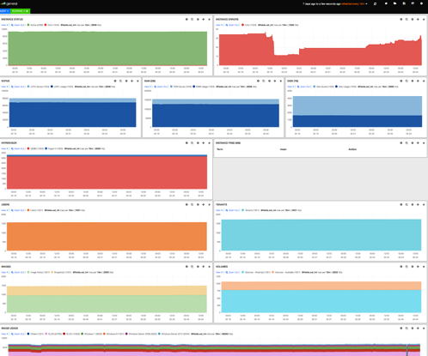
Kibana and ElasticSearch
Open-sourced monitoring tools developed by Elastic
ElasticSearch is a lucene based scalable search engine.
Kibana is a visualization tool for ElasticSearch and provides a web interface with variety ways of visualization.
Users: KEK, CERN, Facebook, GitHub, Stack Exchange, …
Search
Engine
Visualization
tool
Dashboard
Logs
Elastic
Search
Kibana
Metrics
dashboards

Slide 3

Motivation
Kibana + ElasticSearch lack access control feature
Multiple users/groups use single Kibana + ElasticSearch
Any user can access to all ElasticSearch data
Need access control
Kibana
ElasticSearch
User01
User01
dashboard
User02
dashboard
・・・
Problem
User01 SECRET
data
・・・
User02

Slide 4

Example: Solution of CERN Cloud team
Provided cloud utilization dashboard to each cloud user
Developed an ES plugin which provides user specific filter
User only gets own cloud tenants utilization
Appends tenant_id=“1234567890” condition
query
query
dashboards
CERN
SSO
Httpd
Kibana
ES
plugin
ES
Cloud utilizations
user01
username
user-tenant mapping file
#userid admin_flag tenant_id
user01 0 1234567890
...

Slide 5
We Provide Alternative Solution
Based on the CERN’s solution
Enables access restriction on ElasticSearch and Kibana dashboard separation.
 | CERN’s solution | Our solution
SSO integration | Shibboleth | Kerberos
ElasticSearch plugin | Homemade | SearchGuard
ElasticSearch Access restriction | User based; Document level | User/group based; Index, type, operation, document level
Kibana Dashboard separation | Per user | Per user/group (Created Kibana plugin)

Slide 6
What we did
Kerberos 5 authentication integration.
Development of a Kibana plugin which makes it possible to separate Kibana dashboards based on user/group.
User/group based access control on ElasticSearch by SearchGuard.
Measurement on performance deterioration from using SearchGuard.

Slide 7
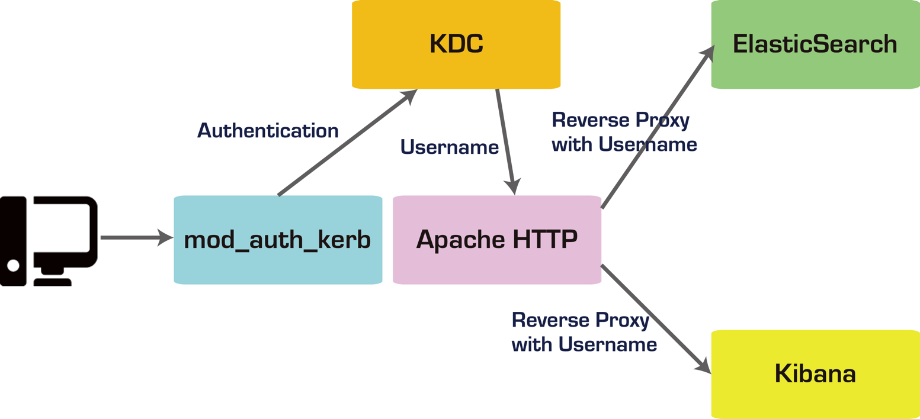
1. Kerberos 5 Authentication Integration
Apache mod_auth_kerb module + reverse proxy
Only authenticated users can access to ES and Kibana

Slide 8
2. Development of a Kibana plugin: Motivation
Problem
1 Kibana instance uses only 1 Kibana index (1 database)
All user’s dashboards are stored in the same index
Separate the index for access control
User02
dashboard
User04
dashboard
User01
dashboard
User03
dashboard
User02
dashboard
.kibana
.kibana_user02
User01
dashboard
.kibana_user01

Slide 9
Development of a Kibana plugin: Motivation
Group based Kibana index separation is useful
Users can share a Kibana index among a group
share group dashboards
group01
dashboard02
group01
dashboard01
.kibana_group01
group01

Slide 10
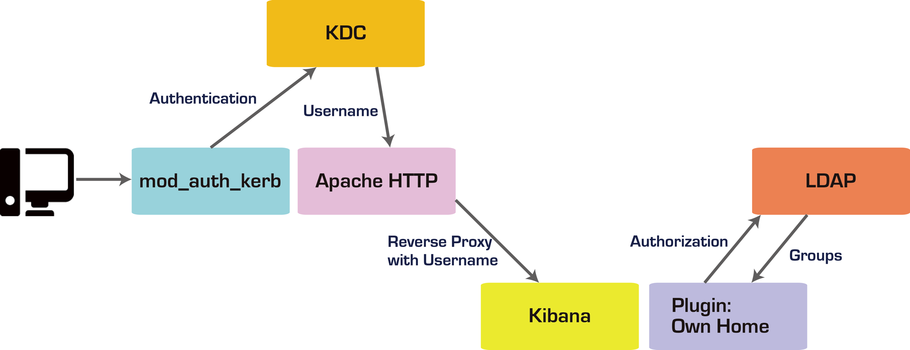
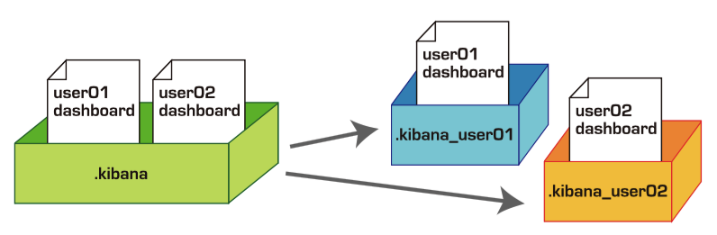
Development of a Kibana plugin
Adds multi-tenancy
User can switch Kibana index for personal or group shared use.
User01
dashboard
.kibana_user01
group01
dashboard02
group01
dashboard01
.kibana_group01
Developed

Slide 11
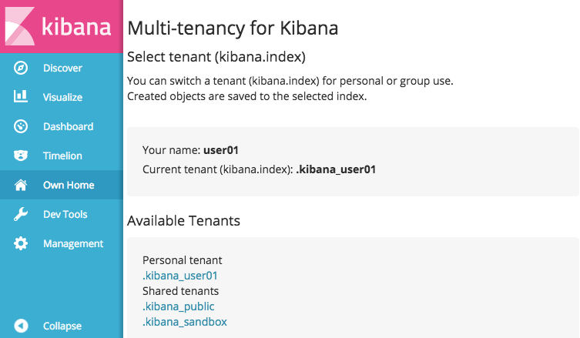
Kibana plugin: Own Home
https://github.com/wtakase/kibana-own-home

Slide 12
3. User/group based Access control on ElasticSearch
Need ElasticSearch index level access control.
The Kibana plugin separates Kibana index, but still all users can access other’s index.
User01
data01
User01
data02
User01_secret_index
User02
dashboard
user01
User01
dashboard
.kibana_user02
.kibana_user01
user02

Slide 13
Investigation of SearchGuard
ElasticSearch plugin
Flexible REST/transport layer access control based on user/group
Index, type, operation, document level restrictions
Node-to-node encryption
Supported by Floragunn
http://floragunn.com/searchguard
https://github.com/floragunncom/search-guard

Slide 14
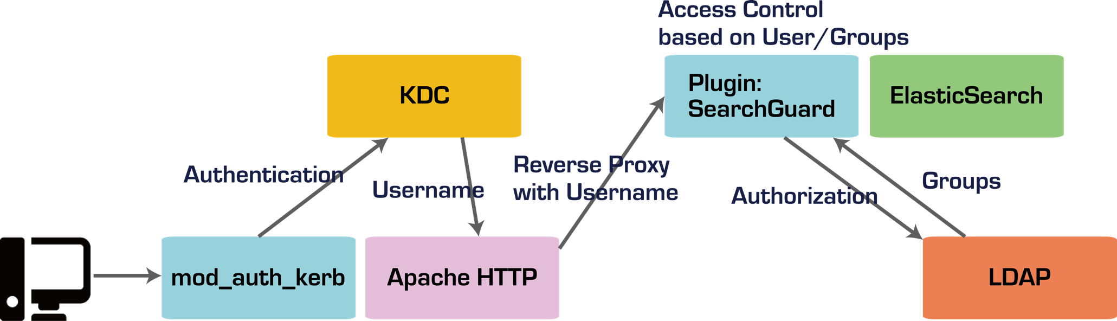
SearchGuard + LDAP Authorization
SearchGuard supports multiple auth back-ends
YAML files based configuration
We use proxy based authentication and LDAP authorization features for user/group based access control.
Proxy based authentication
LDAP authorization

Slide 15
Development related to SearchGuard: Motivation
Each user has a own Kibana index and each index allows access only from the owner.
Admin has to define permissions for every user.
Whenever new user is registered, admin has to add permission.
sg_roles.yml
sg_roles_mapping.yml
kibana_user01_index:
indices:
‘.kibana_user01’:
‘*’:
- ALL
kibana_user02_index:
indices:
‘.kibana_user02’:
‘*’:
- ALL
. . .
kibana_user01_index:
users:
user01
kibana_user02_index:
users:
user02
. . .
Permission for user01
Permission for user02

Slide 16
Development of a SearchGuard Patch
Enables to set username variable in configuration file and releases the admin from the troublesome task
Has been merged to upstream
sg_roles.yml
sg_roles_mapping.yml
kibana_own_index:
indices:
‘.kibana_${user_name}’:
‘*’:
- ALL
kibana_own_index:
users:
‘*’

Slide 17
Contributions to SearchGuard for more flexible configurations
Support configurable OID
https://github.com/floragunncom/search-guard/pull/168
Use username variable at indices sections in sg_roles.yml
https://github.com/floragunncom/search-guard/pull/169
Support and_backendroles
https://github.com/floragunncom/search-guard/pull/247
Add skip_users option
https://github.com/floragunncom/search-guard-authbackend-ldap/pull/1

Slide 18
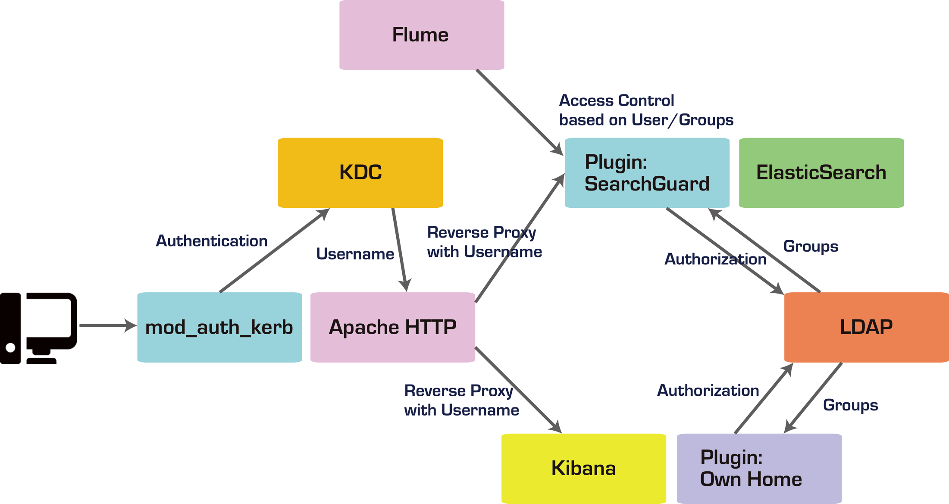
Overview of Our Solution
patch
patch
patch
patch
patch
Developed

Slide 19
4. Measurement of SearchGuard-ed ElasticSearch Performance by Rally
What is Rally?
Benchmarking tool for ElasticSearch
https://www.elastic.co/blog/announcing-rally-benchmarking-for-elasticsearch
https://github.com/elastic/rally
Measures indexing throughput, query latencies
Provides a few default scenarios and user can define customized one

Slide 20
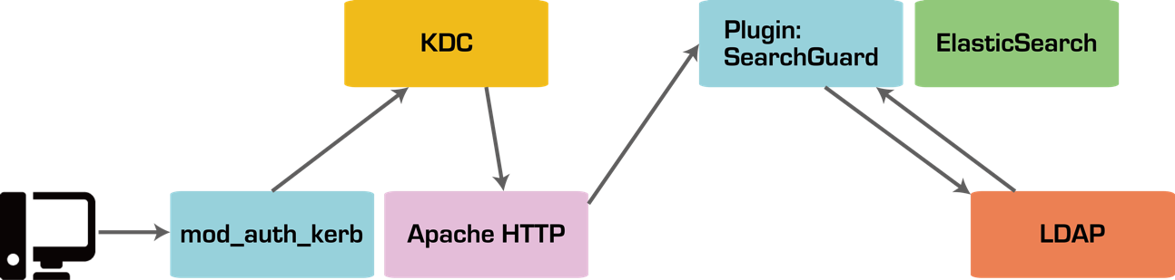

Test Scenario
Used Rally default scenario named “geonames”
Uses geographical dataset
Data source: http://www.geonames.org/
Indexes 8.6M documents (total 2.8GB) and 5000 docs per bulk request against ElasticSearch
Compared performance between normal ElasticSearch and SearchGuard-ed ElasticSearch
Rally
vs
Rally

Slide 21
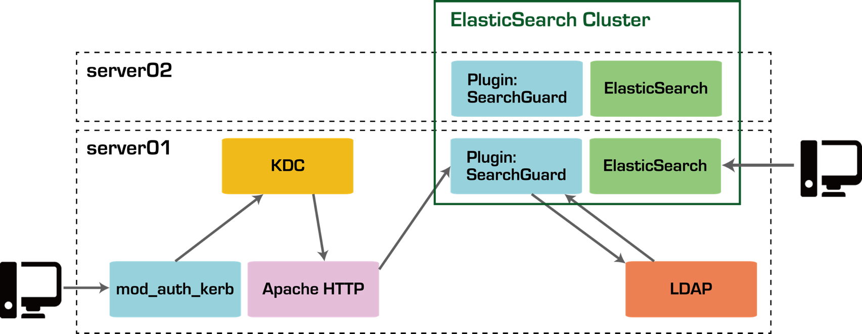
Test Environment
ElasticSearch Rally 0.3.1
Normal ElasticSearch
SearchGuard-ed ElasticSearch
 | server01 and server02
OS | CentOS 7
CPU | AMD Opteron 6212 2.6GHz 8 cores
RAM | 8 GB
ElasticSearch | 2.3.4
SearchGuard | 2.3.4

Slide 22
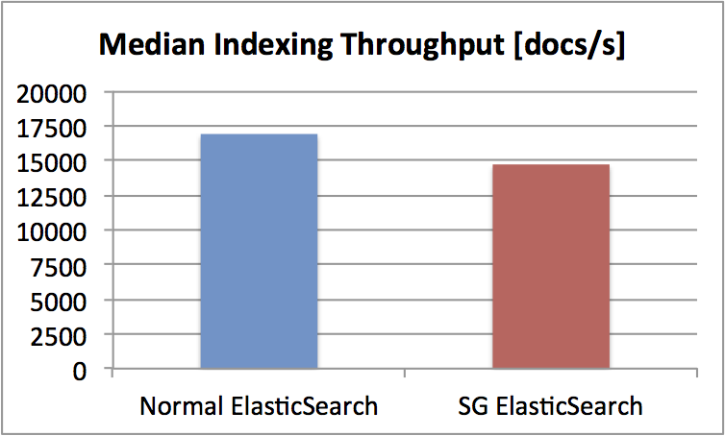
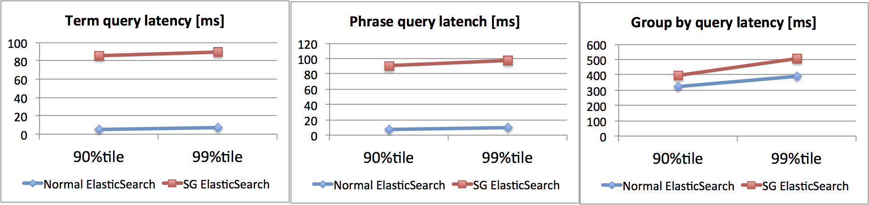
Results
Document indexing throughput
Query latencies
Term matching query
Phrase matching query
“Group by” query
13% degradation
82ms
87ms
116ms
99%tile: 99% queries completed in under a given latency
Overhead of each query can be estimated as 80〜120ms by 90% and 99% of queries completion lines.
Kerberos authentication, Reverse proxy, LDAP lookup, Search Guard access control

Slide 23
Summary
In multi-user environment, user/group based access restriction and dashboard separation are necessary for secure use of Kibana and ElasticSearch.
We provided alternative solution based on the CERN cloud team’s one.
Kerberos 5 authentication integration
Kibana plugin separates Kibana dashboards based on user/group
SearchGuard enables access control on ElasticSearch and patches for SearchGuard enabling flexible access control have been merged to the upstream
We measured performance of SearchGuard-ed ElasticSearch and compared to the normal one:
Overhead of indexing throughput: 13%
Estimated overhead of each query: 80〜120ms

